Slide 1
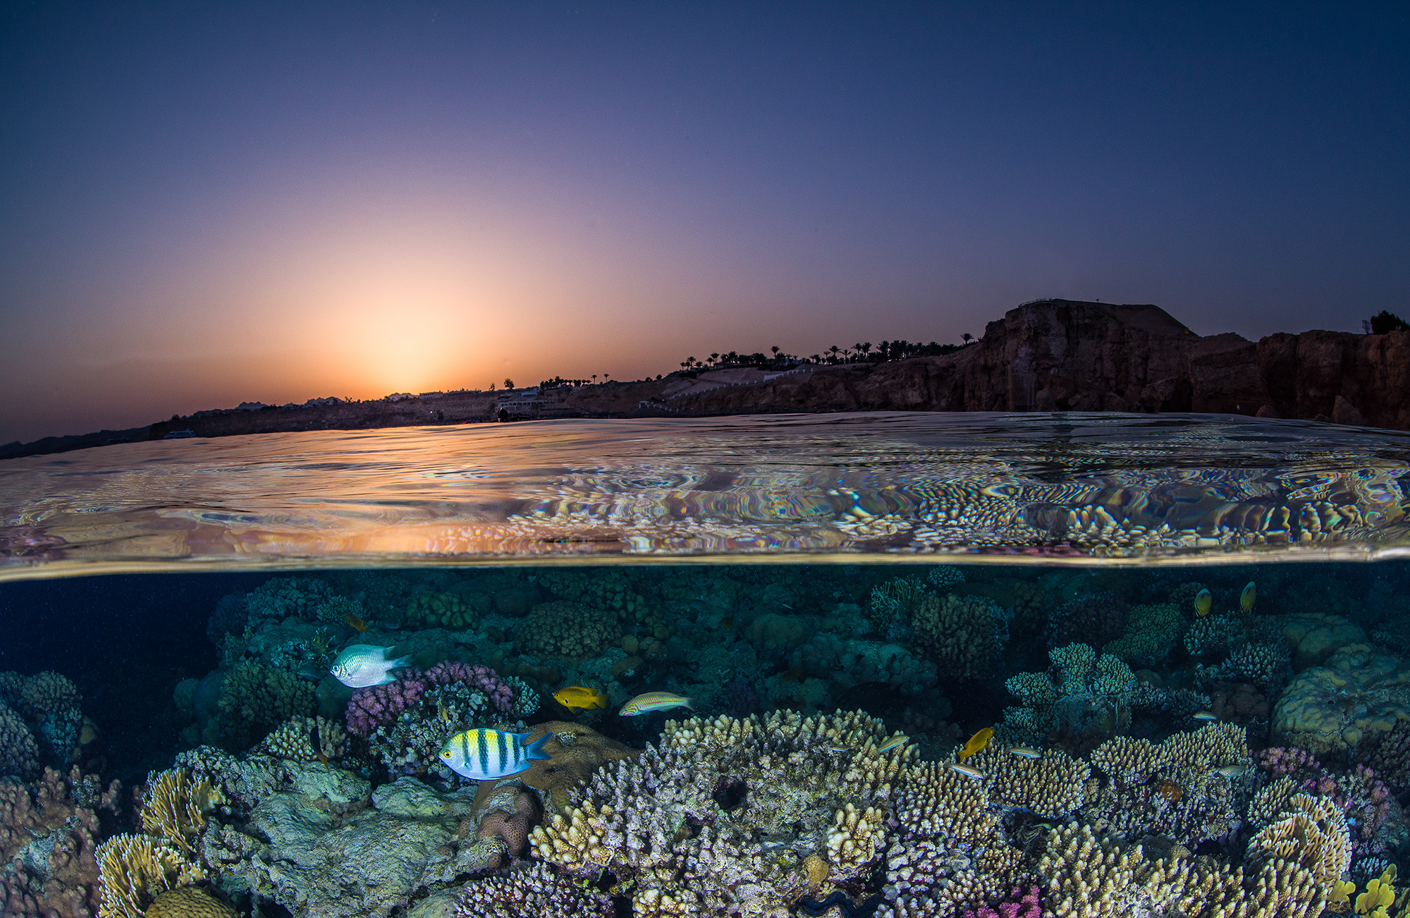
Coral Reef Community of Ocean Action
United Nations Environment Programme International Coral Reef Initiative
Takehiro Nakamura Chief, Marine and Coastal Ecosystems Unit United Nations Environment Programme (UNEP)
Photo credit: Brook Peterson

Slide 2
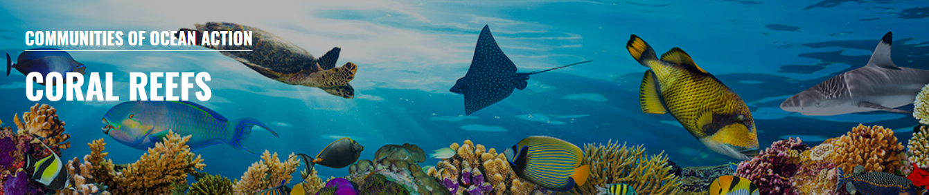

 | 107 members (2 additional members since May 2019) 158 commitments (22 additional commitments since May 2019) 30.4% reporting rate (4% increase from May 2019)

Slide 3
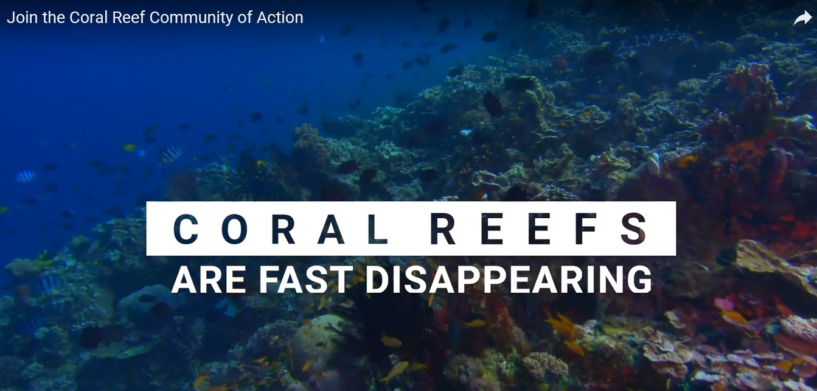
https://www.youtube.com/watch?v=L0ktCOeXJH0
Video on the Coral Reef Community of Ocean Action produced with support by Swedish Ministry of Environment

Slide 4

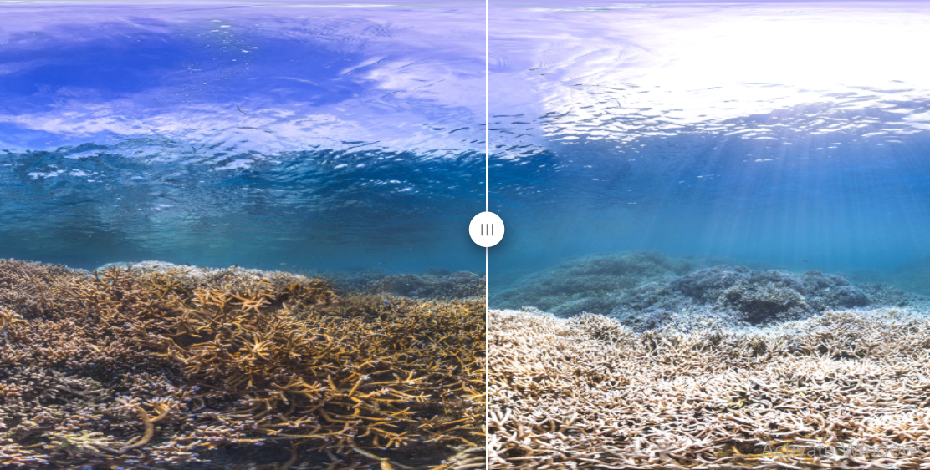
Global Coral Reef Monitoring Network
 | New global report on the status of coral reefs to be launched in May 2021 Largest coral reef data set ever assembled (40 years of data, more than 75 countries, hundreds of scientists, over 2 million observations) First global GCRMN report since 2008 Indication of SDG target 14.2 achievement from the coral reef perspective

Slide 5
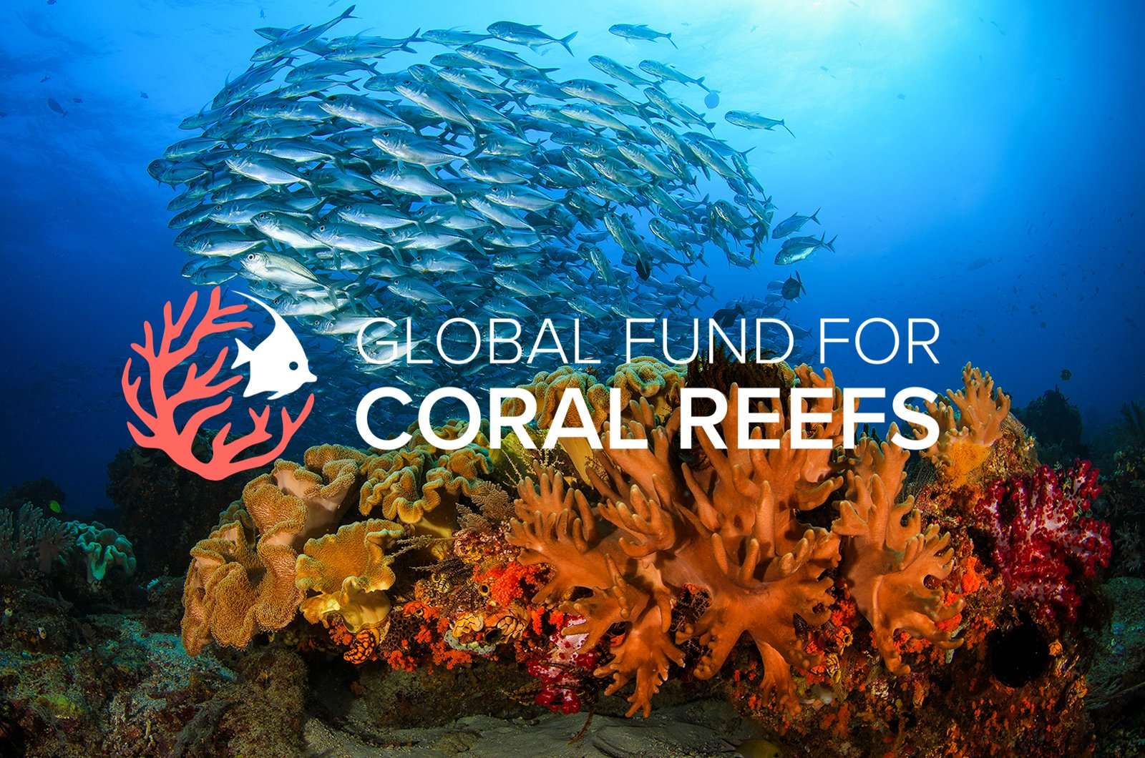
Global Fund for Coral Reefs
 | Board members: UN Multi-Partner Trust Fund (host), UNDP, UNCDF, UNEP, Vulcan (founder), Prince Albert II of Monaco Foundation (founder), Germany (donor) Aims to be a 10-year, US$ 500 million blended finance vehicle for coral reef conservation

Slide 6
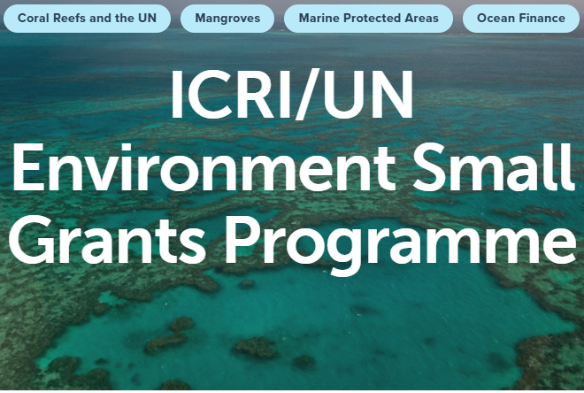
UNEP/ICRI Small Grants Programme
 | Second phase of funding Grants up to USD 80,000 Sustainable management, protection and restoration of coral reefs, mangroves and seagrass Implementing UNEP and ICRI guidelines

Slide 7
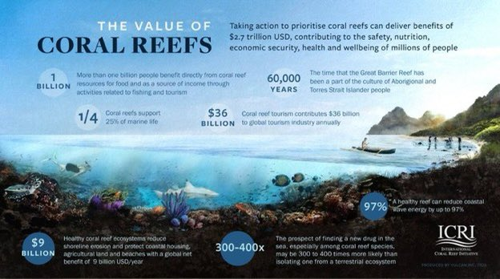
ICRI recommendations on coral reefs to the post 2020 global biodiversity framework
Calls for prominent recognition of coral reef ecosystems within the text of the CBD Post-2020 Global Biodiversity Framework
Emphasises appropriate timescales for the goals and targets (e.g. 2050)
Encourages explicit inclusion of coral reef indicators within any monitoring framework

Slide 8
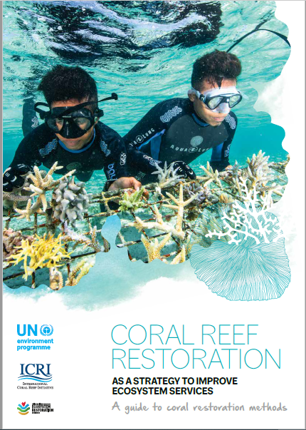
Coral reef restoration best practices
 | UNEP/ICRI coral reef restoration best practices report published in January 2021 Initiates the UN Decade on Ecosystem Restoration 2021 – 2030 Requested by UNEA Resolution 4/13

Slide 9
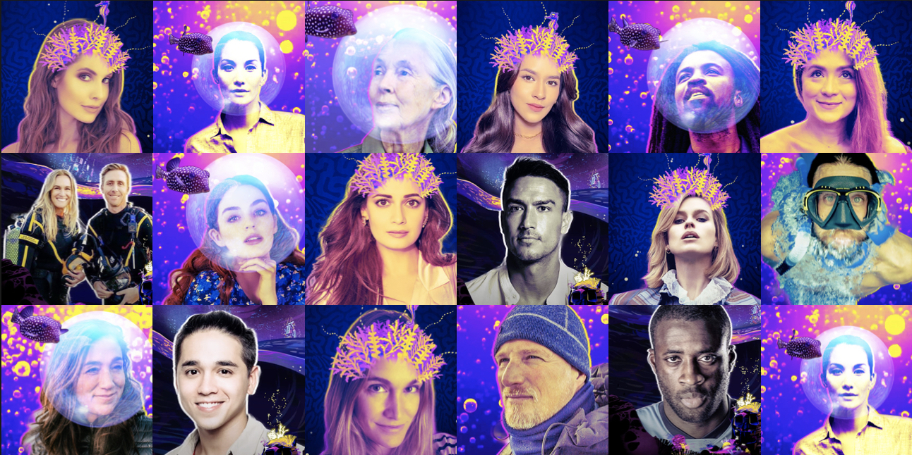
Social Media Campaign – Glowing Glowing Gone Campaign www.glowing.org
UNEP has promoted the visibility of coral reefs
Partnership with Adobe and The Ocean Agency
Celebrity and ocean expert influencer social media campaign
Reef Life Exhibition at Beijing Capital International Airport
Support by leaders to ICRI recommendations
Digital Interactive Story to support the GCRMN Reports

Slide 10
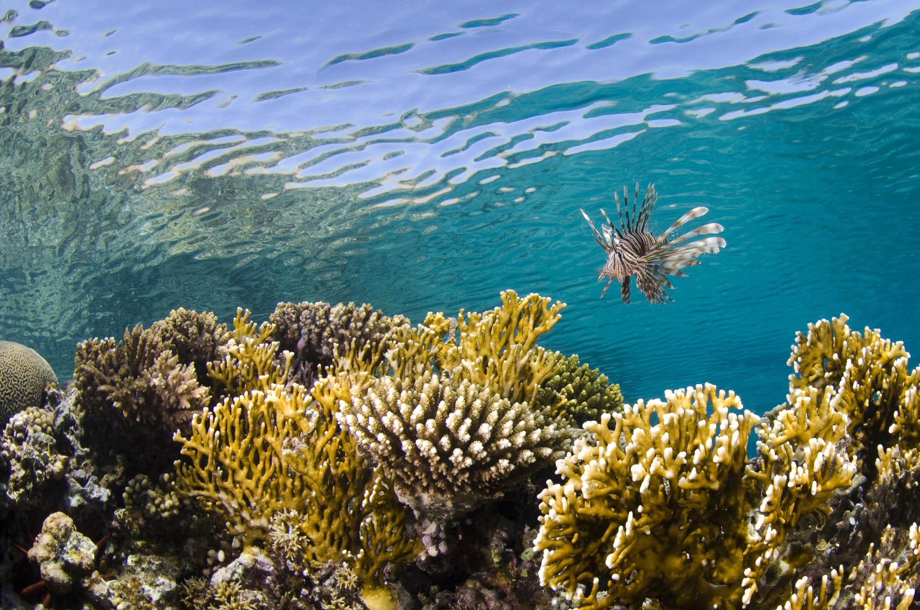
Thank you
 | www.unep.org www.icriforum.org

